Slide 1
Heart Attack Analysis & Prediction
Final Project - Yurham Afif

Slide 2
Heart Attack Analysis & Prediction Dataset
Objective Statement:
Challenges:
Success Criteria:
Get health understanding that affect heart attack
Source Data:
Heart Attack Analysis & Prediction Dataset
heart.csv
Data understanding - health and medical
Method/Analytic Technique:
Descriptive analysis
Graph analysis
Explore the relation of health condition and heart attack
Expected Outcome
Preventive act of heart attack disease
predict disease based on the data

Slide 3
Topic understanding
What’s heart attack?
What can we grasp?
A heart attack occurs when the flow of blood to the heart is blocked. The blockage is most often a buildup of fat, cholesterol and other substances, which form a plaque in the arteries that feed the heart (coronary arteries)
So, behavioural data is important for predict the causality of heart attack. Hence we can do some prevention steps.
What is the most affecting factor to heart attack in 10 years?

Slide 4
Data Understanding
The dataset is publically available on the Kaggle website, and it is from an ongoing cardiovascular study on residents of the town of Framingham, Massachusetts. The classification goal is to predict whether the patient has 10-year risk of future coronary heart disease (CHD).The dataset provides the patients’ information
Age : Age of the patient
Sex : Sex of the patient
exang: exercise induced angina (1 = yes; 0 = no)
ca: number of major vessels (0-3)
cp : Chest Pain type chest pain type
Value 1: typical angina
Value 2: atypical angina
Value 3: non-anginal pain
Value 4: asymptomatic
trtbps : resting blood pressure (in mm Hg)
chol : cholestoral in mg/dl fetched via BMI sensor
fbs : (fasting blood sugar > 120 mg/dl) (1 = true; 0 = false)
rest_ecg : resting electrocardiographic results
Value 0: normal
Value 1: having ST-T wave abnormality (T wave inversions and/or ST elevation or depression of > 0.05 mV)
Value 2: showing probable or definite left ventricular hypertrophy by Estes' criteria
thalach : maximum heart rate achieved
thall : thallasemia rate (0 = non carrying 1 = normal; 2 = fixed defect; 3 = reversable defect
target : 0= less chance of heart attack 1= more chance of heart attack

Slide 5
Data Preparation and Cleansing
Preparation
Cleansing
Data used: heart.csv
Code Used: Python Version: 3.7.6
Packages: Pandas, Numpy and Matplotlib.
Check for each column and find if any column is redundant or useless.
Check for missing values.
Check if the data format is already suitable for algorithm.
Check for value that are not consistent with general common sense

Slide 6
Exploratory Data Analysis

Slide 7
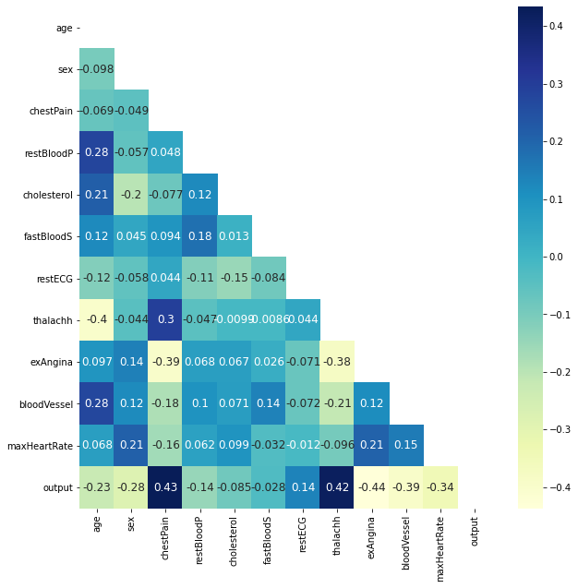
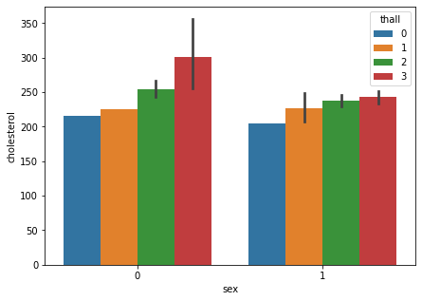
Correlation map - to output (10YearCHD)
chestPain, restECG, maxHeartRate - direct correlation
Age factor affects restBloodP, cholesterol, bloodVessel
Female (0) carry higher risk of cholesterol which related to thalassemia (reversible defect)

Slide 8
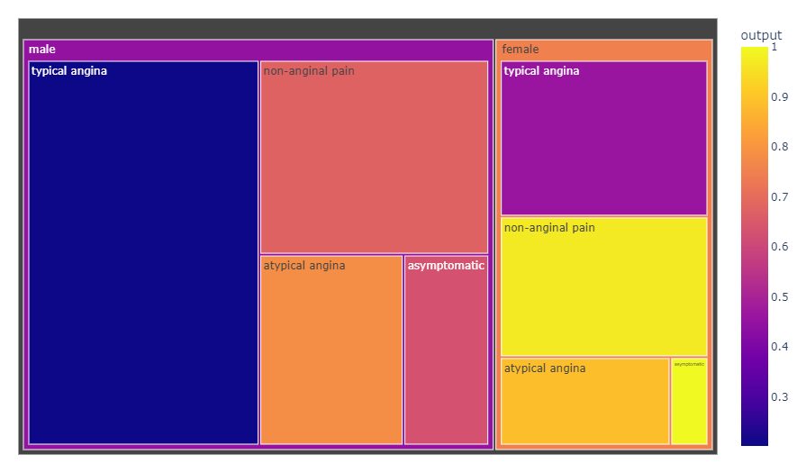
sex vs exAngina (exercise induced chestPain) vs Output
female with asymptomatic and male with atypical angina/chestPain are more likely to have heart attack
female still carry higher risk of heart attack compared to male due to exAngina

Slide 9
Modelling

Slide 10

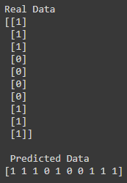
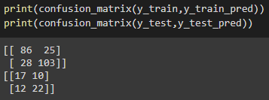
Classification - k-nearest neighbors vote
Real vs predicted data
(1) for positive and (0) for negative case, 10 head data
Training Evaluation
Confusion Matrix

Slide 11
Conclusion?
Thalassemia - genetic factor lead to heart attack due to cholesterol, especially female
female still carry
Mind your age - higher factor lead to heart attack in 10 years
Model accuracy ~70%
Stay Healthy!

Slide 12



Heart Attack Analysis & Prediction
Final Project - Yurham Afif
yurhamafif.edu@gmail.com
Yurham Afif
itsapep

Slide 13
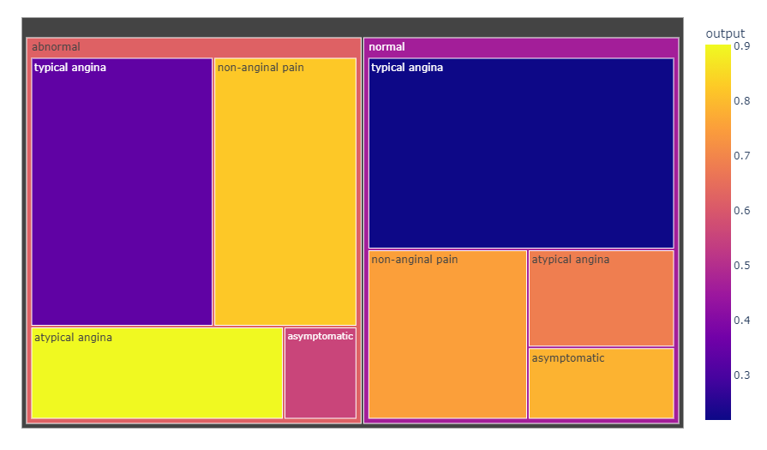
Tuesday and Friday also Promising!
How is the trend of the daily visitors?
The visitor pattern are not quite different with the visit count, but higher intensity of visitor are happened on Tuesday and Friday. This also a promising day to increase sale by add some campaign during weekdays.

Slide 14
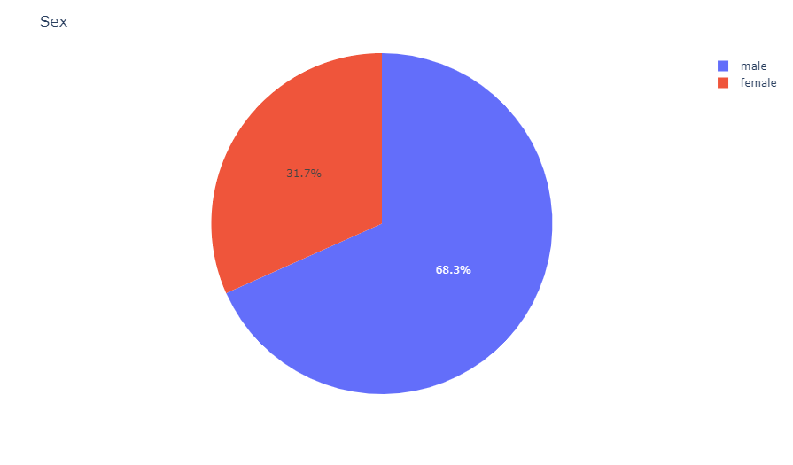
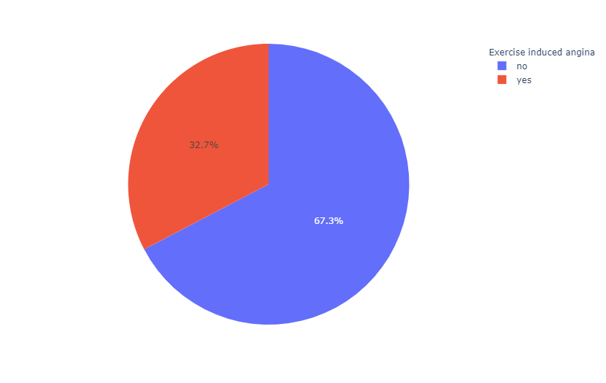
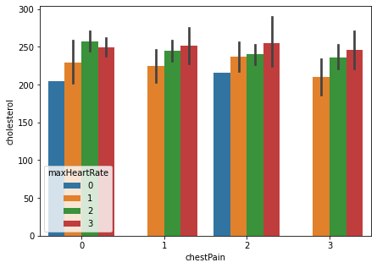
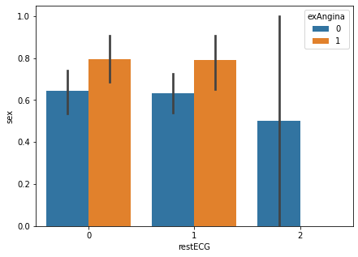
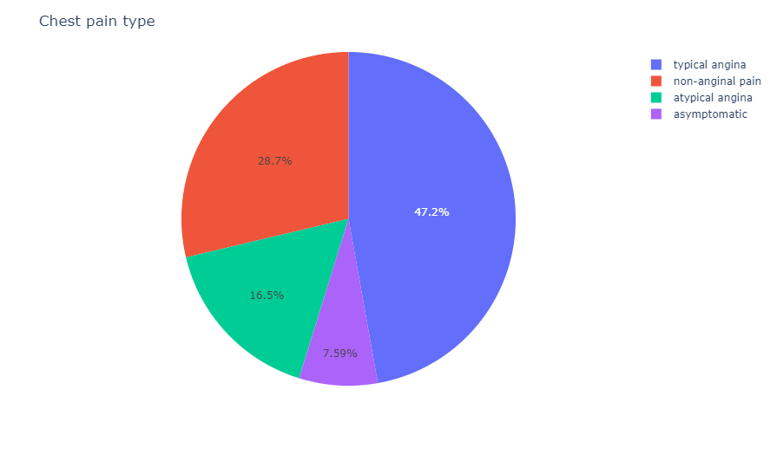
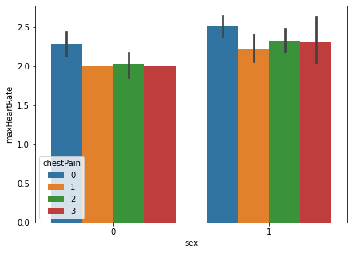
Most
How is the trend of the daily web visit?
High visit are mostly happened in the middle of October and on Sunday every week. It seems like customers tend to hold their desire to open the web in first and last week of the month. The business team are suggested to provide promising campaign during that moment, especially on Sunday.

